Slide 1

MY WORLD
by Bogdan Tošić

Slide 2
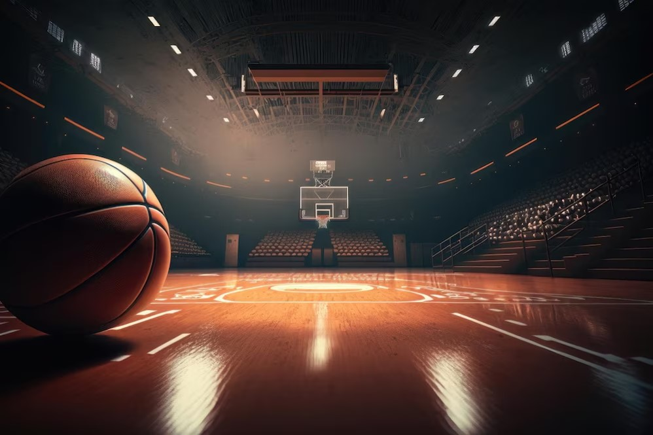
BASKETBALL
Basketball helps me learn patience and strength.
When I play, I try my best.
Every shot is a chance to improve, and every mistake teaches me something new.

Slide 3


MUSIC
Music is very important to me. It helps me relax after a long day and makes me feel happy. Sometimes I listen to music to think and enjoy my time alone.

Slide 4
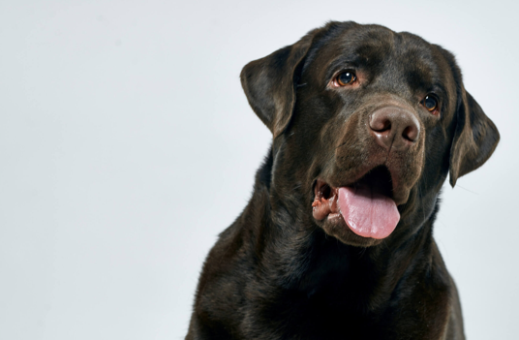
MY LABRADOR
My black labrador is always there for me, with kind eyes and a big heart. He makes me happy when I feel sad. We like to play and spend time together. He is not just a pet, he is also my best friend.

Slide 5

This is my world a balance of sport, music, and love. Simple, strong and always real.

